Slide 1

CHAPTER 11
ANALYSIS OF
ALGORITHM
EFFICIENCY
Copyright © Cengage Learning. All rights reserved.

Slide 2
SECTION 11.2
O-, Ω-, and Θ-Notations
Copyright © Cengage Learning. All rights reserved.

Slide 3
O-, Ω-, and Θ-Notations
It often happens that any one of several algorithms could be used to do a certain job but the time or memory space they require varies dramatically.
The O-, Ω-, and Θ-notations provide approximations that make it easy to evaluate large-scale differences in algorithm efficiency, while ignoring differences of a constant factor and differences that occur only for small sets of input data.

Slide 4
O-, Ω-, and Θ-Notations
The idea of the notations is this. Suppose f and g are
real-valued functions of a real variable x.
1. If, for sufficiently large values of x, the values of |f | are
less than those of a multiple of |g|, then f is of order at
most g, or f (x) is O(g (x)).
2. If, for sufficiently large values of x, the values of |f | are
greater than those of a multiple of |g|, then f is of order at
least g, or f (x) is Ω(g (x)).
3. If, for sufficiently large values of x, the values of |f | are
bounded both above and below by those of multiples of
|g|, then f is of order g, or f (x) is Θ(g (x)).

Slide 5
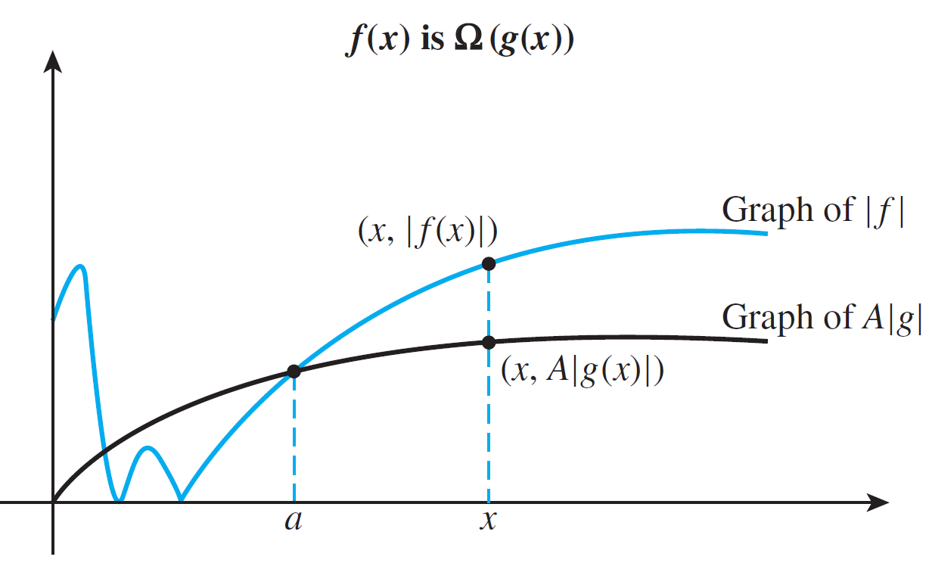
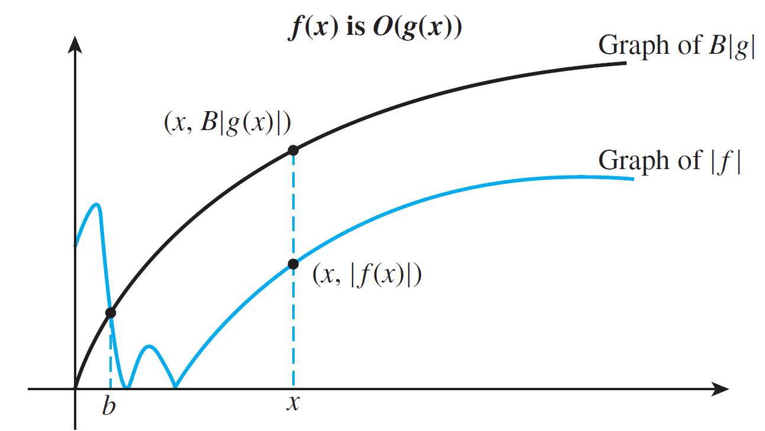
O-, Ω-, and Θ-Notations
These relationships are illustrated in Figure 11.2.1.
Figure 11.2.1

Slide 6
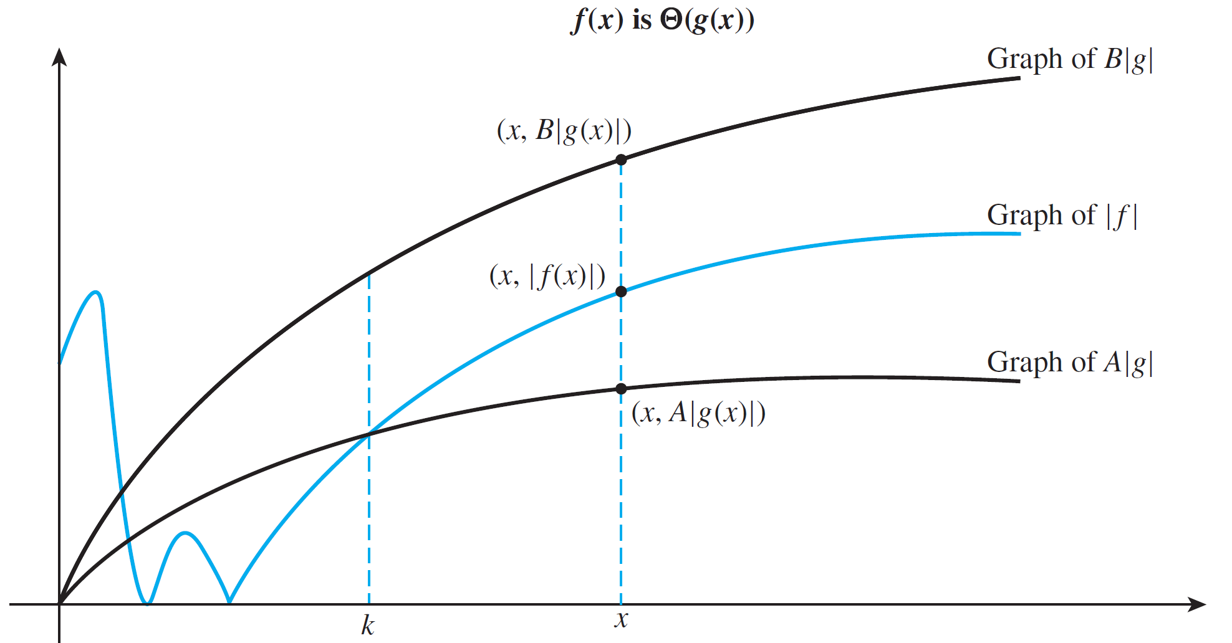
O-, Ω-, and Θ-Notations
Figure 11.2.1 (continued)

Slide 7
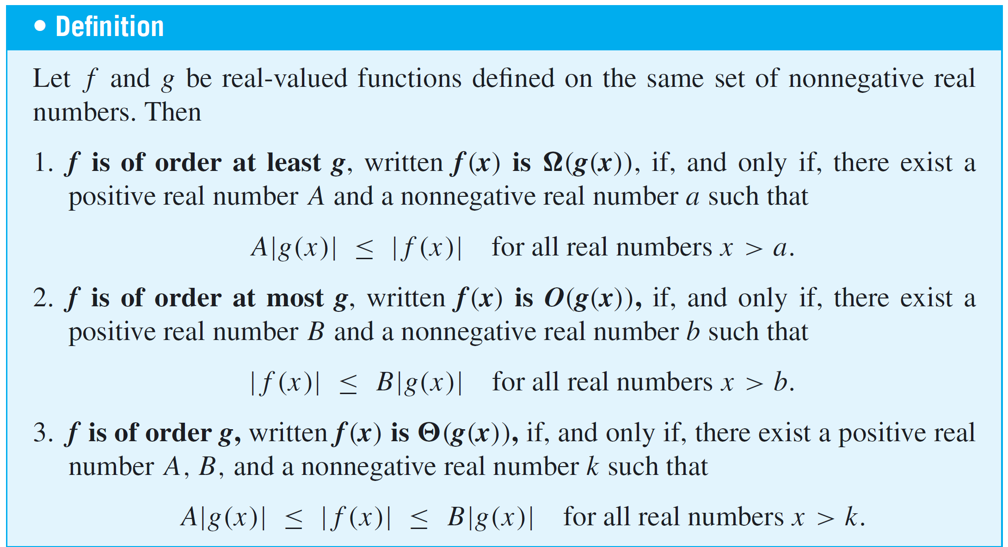
O-, Ω-, and Θ-Notations

Slide 8
Example 1 – Translating to Θ-Notation
Use Θ-notation to express the statement
for all real numbers x > 2.
Solution:
Let A = 10, B = 30, and k = 2.
Then the statement translates to
for all real numbers x > k.

Slide 9
Example 1 – Solution
cont’d
So, by definition of Θ-notation,

Slide 10
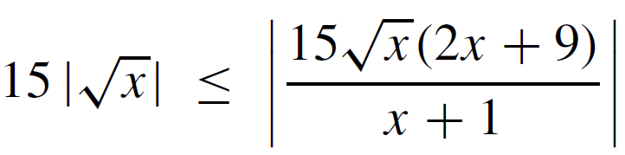
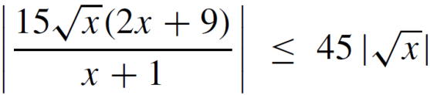
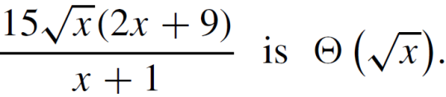
Example 2 – Translating to O- and Ω-Notations
a. Use Ω and O notations to express the statements
for all real numbers x > 0.
for all real numbers x > 7.
b. Justify the statement:

Slide 11
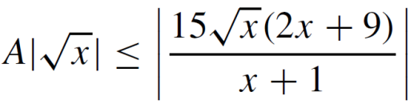
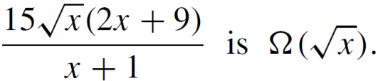
Example 2(a) – Solution
Let A = 15 and a = 0. The given statement translates to
for all real numbers x > a.
So by definition of Ω-notation,

Slide 12
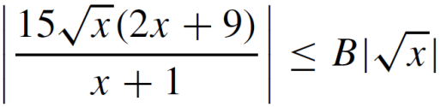
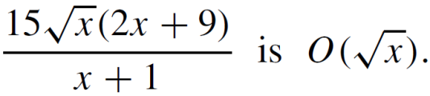
Example 2(a) – Solution
cont’d
Let B = 45 and b = 7. The given statement translates to
for all real numbers x > b.
So by definition of O-notation,

Slide 13
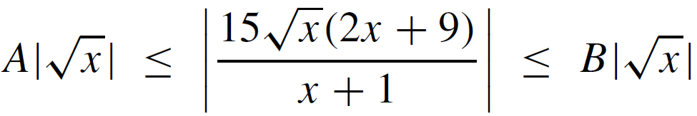
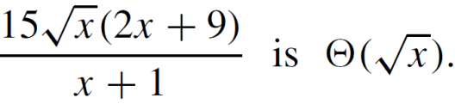
Example 2(b) – Solution
cont’d
Let A = 15, B = 45, and let k be the larger of 0 and 7.
Then when x > k, both inequalities in a(i) and a(ii) are satisfied, and so
for all real numbers x > k.
Hence by definition of Θ-notation,

Slide 14
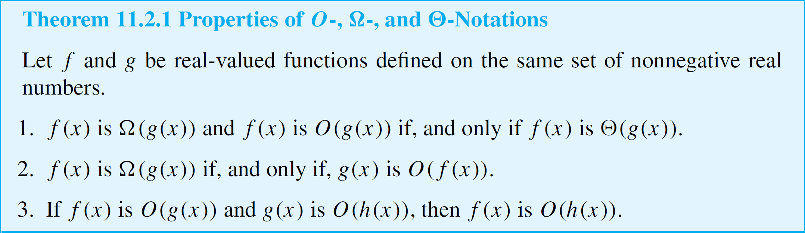
O-, Ω-, and Θ-Notations

Slide 15
Orders of Power Functions

Slide 16

Orders of Power Functions
Observe that if 1 < x,
then x < x²
and so x² < x³
Thus if 1 < x, then 1 < x < x² < x³.

Slide 17
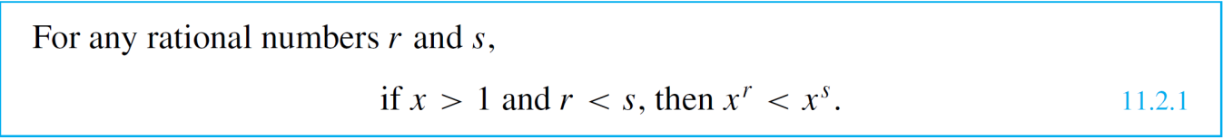
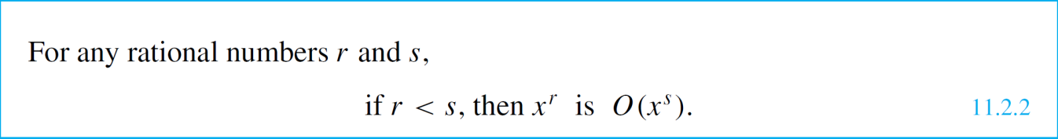
Orders of Power Functions
The following is the generalization of these results:
Property (11.2.1) has the following consequence for orders.

Slide 18
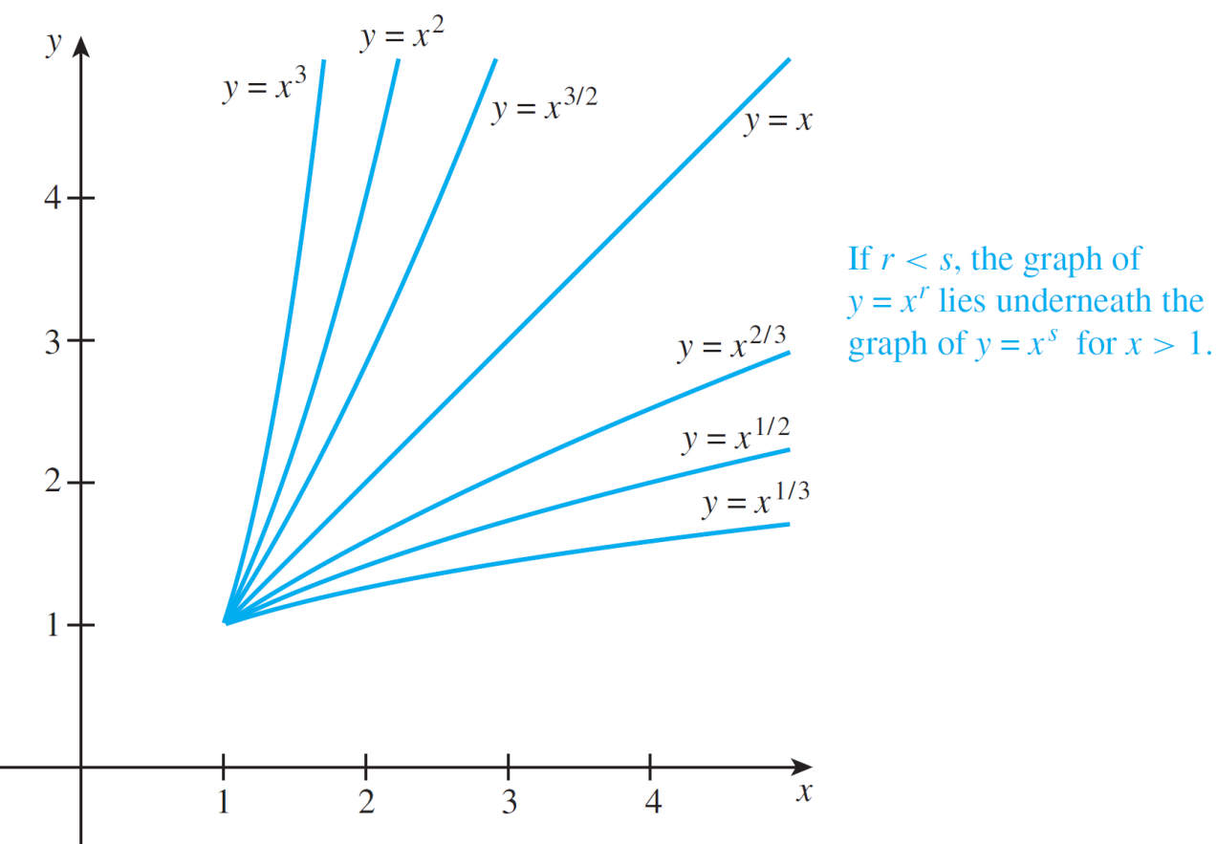
Orders of Power Functions
The relation among the graphs of various positive power functions of x for x ≥ 1 is shown graphically in Figure 11.2.2.
Graphs of Powers of x for x ≥ 1
Figure 11.2.2

Slide 19
Orders of Polynomial Functions

Slide 20
Orders of Polynomial Functions
Example 4 shows that a polynomial function has a certain order.

Slide 21


Example 4 – Using the Definitions to Show That a Polynomial Function with
Positive Coefficients Has a Certain Order
Use the definitions of big-Omega, big-O, and big-Theta to show that 2x⁴ + 3x³ + 5 is Θ(x⁴).
Solution:
Define functions f and g as follows. For all nonnegative real numbers x,
, and

Slide 22






Example 4 – Solution
cont’d
Observe that for all real numbers x > 0,
and so
Let A = 2 and a = 0. Then
for all x > a,
and so by definition of Ω-notation,

Slide 23




Example 4 – Solution
cont’d
Also for x > 1,

Slide 24


Example 4 – Solution
cont’d
Let B = 10 and b = 1. Then
for all x > b,
and so, by definition of O-notation, .
Since by Theorem 11.2.1, it is Θ(x⁴).

Slide 25



Example 6 – A Big-Omega Approximation for a Polynomial with Some
Negative Coefficients
a. Use the definition of Ω-notation to show that
b. Show that for all integers r < 3.
Solution:
a. To show that , you need to find
numbers a and A so that
for all real numbers x > a.
Choose a as follows: Add up the absolute values of the
coefficients of the lower-order terms of
divide by the absolute value of the highest-power
term, and multiply the result by 2.

Slide 26

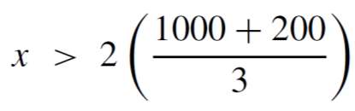


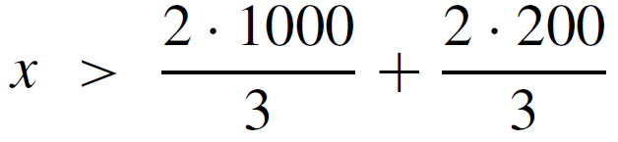

Example 6 – Solution
cont’d
The result is a = 2(1000 + 200)/3, which equals 800.
If you follow the steps below, you will see that when a is chosen in this way, A can be taken to be one-half of the absolute value of the highest power of the polynomial.
Accordingly, assume that x > a. Then

Slide 27
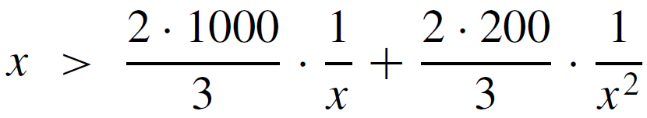
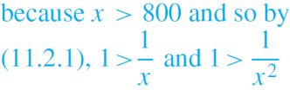
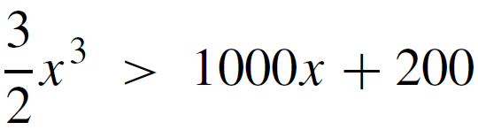
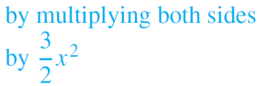
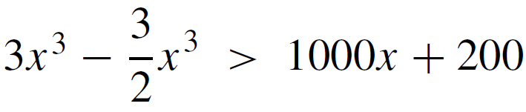

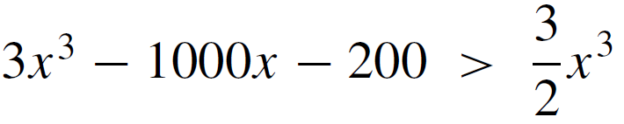
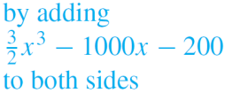
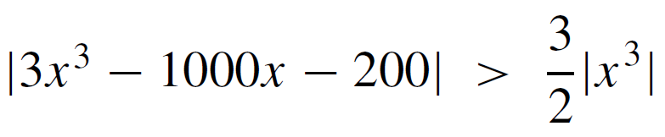
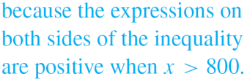
Example 6 – Solution
cont’d

Slide 28

Example 6 – Solution
cont’d
Let A = and let a = 800. Then
for all real numbers x > a.
So, by definition of Ω-notation,

Slide 29
Example 6 – Solution
cont’d
b. Suppose r is an integer with r < 3. By property (11.2.1),
x^{r} < x³ for all real numbers x > 1.
So, since a = 800 > 1, A|x^{r} | < A|x³| for all real numbers
x > a. Thus, by part (a),
Hence, by definition of Ω-notation,
for all integers r < 3.

Slide 30
Orders of Polynomial Functions
By Theorem 11.2.1, it follows immediately from Example 6(a) that 3x³ – 1000x – 200 is big-Theta of x³, and the techniques used in the example can be generalized to show that every polynomial is big-Theta of the power function of its highest power.
Moreover, the finding in part (b) of the example—that
3x³ – 1000x – 200 is also big-O of x^{s} for every integer s greater than 3 and is big-Omega of x^{r} for every integer r less than 3—can also be generalized to all polynomials.

Slide 31
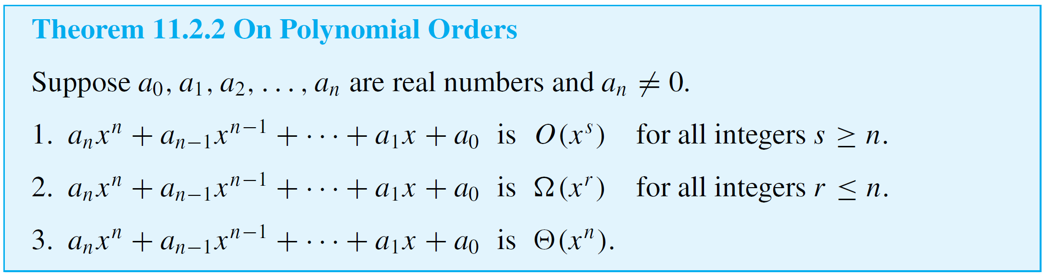
Orders of Polynomial Functions
These facts are summarized in the next theorem.

Slide 32
Example 8 – Showing That Two Power Functions Have Different Orders
Show that x² is not O(x), and deduce that x² is not Θ(x).
Solution:
[Argue by contradiction.] Suppose that x² is O(x). [Derive a contradiction.]
By the supposition that x² is O(x), there exist a positive real number B and a nonnegative real number b such that

Slide 33





Example 8 – Solution
cont’d
Let x be a positive real number that is greater than both B and b.
Then
Thus there is a real number x > b such that
This contradicts (∗). Hence the supposition is false, and so x² is not O(x).

Slide 34
Example 8 – Solution
cont’d
By Theorem 11.2.1, if x² is Θ(x), then x² is O(x). But x² is not O(x), and thus x² is not Θ(x).

Slide 35
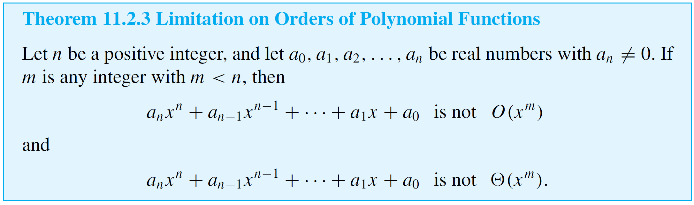
Orders of Polynomial Functions
The technique used in Example 8 can be extended and generalized to prove that any polynomial function in x of degree n is not big-O (or big-Theta) of the mth power
function x^{m} for any m < n.

Slide 36
Orders for Functions of Integer Variables

Slide 37
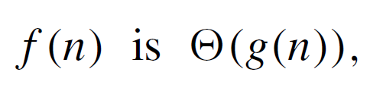

Orders for Functions of Integer Variables
It is traditional to use the symbol x to denote a real number variable, whereas n is used to represent an integer variable. Thus, given a statement of the form
we assume that f and g are functions defined on sets of integers. If it is true that
where f and g are functions defined for real numbers, then it is certainly true that f (n) is Θ(g(n)).

Slide 38
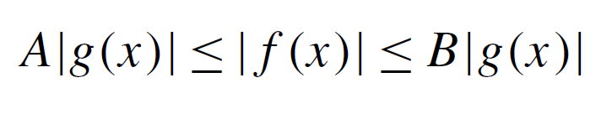
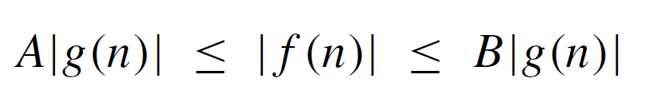
Orders for Functions of Integer Variables
The reason is that if f (x) is Θ(g(x)), then an inequality
holds for all real numbers x > k. Hence, in particular, the inequality
holds for all integers n > k.

Slide 39
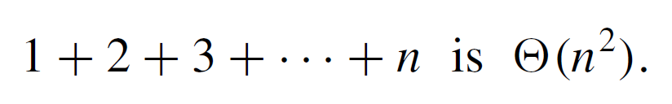
Example 9 – An Order for the Sum of the First n Integers
Sums of the form 1 + 2 + 3 + · · · + n arise in the analysis of computer algorithms such as selection sort. Show that for a positive integer variable n,

Slide 40
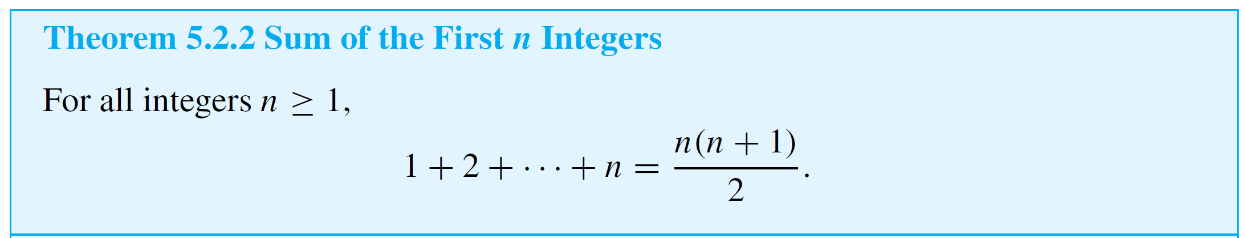
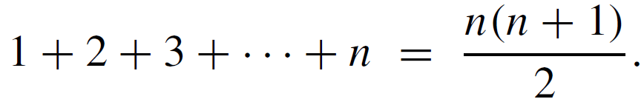
Example 9 – Solution
By the formula for the sum of the first n integers (see Theorem 5.2.2), for all positive integers n,

Slide 41
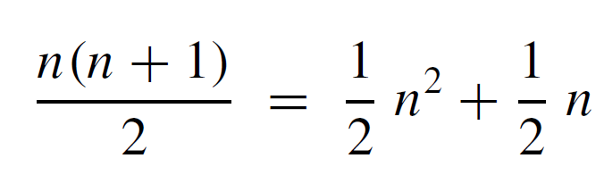

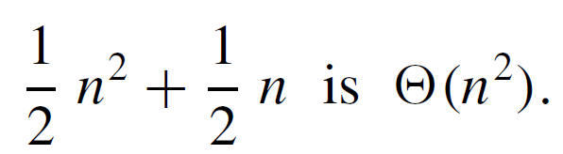

Example 9 – Solution
cont’d
But
And, by the theorem on polynomial orders,
Hence

Slide 42
Extension to Functions Composed
of Rational Power Functions

Slide 43
Extension to Functions Composed of Rational Power Functions
When the numerator and denominator are expanded, each is a sum of terms of the form ax^{r}, where a is a real number and r is a positive rational number.
The degree of such a sum can be taken to be the largest exponent of x that occurs in one of its terms.
If the difference between the degree of the numerator and that of the denominator is called the degree of the function and denoted d, then it can be shown that f (x) is Θ(x^{d}),
that f (x) is O(x^{c}) for all real numbers c > d, and that f (x) is not O(x^{c}) for any real number c < d.

Slide 44
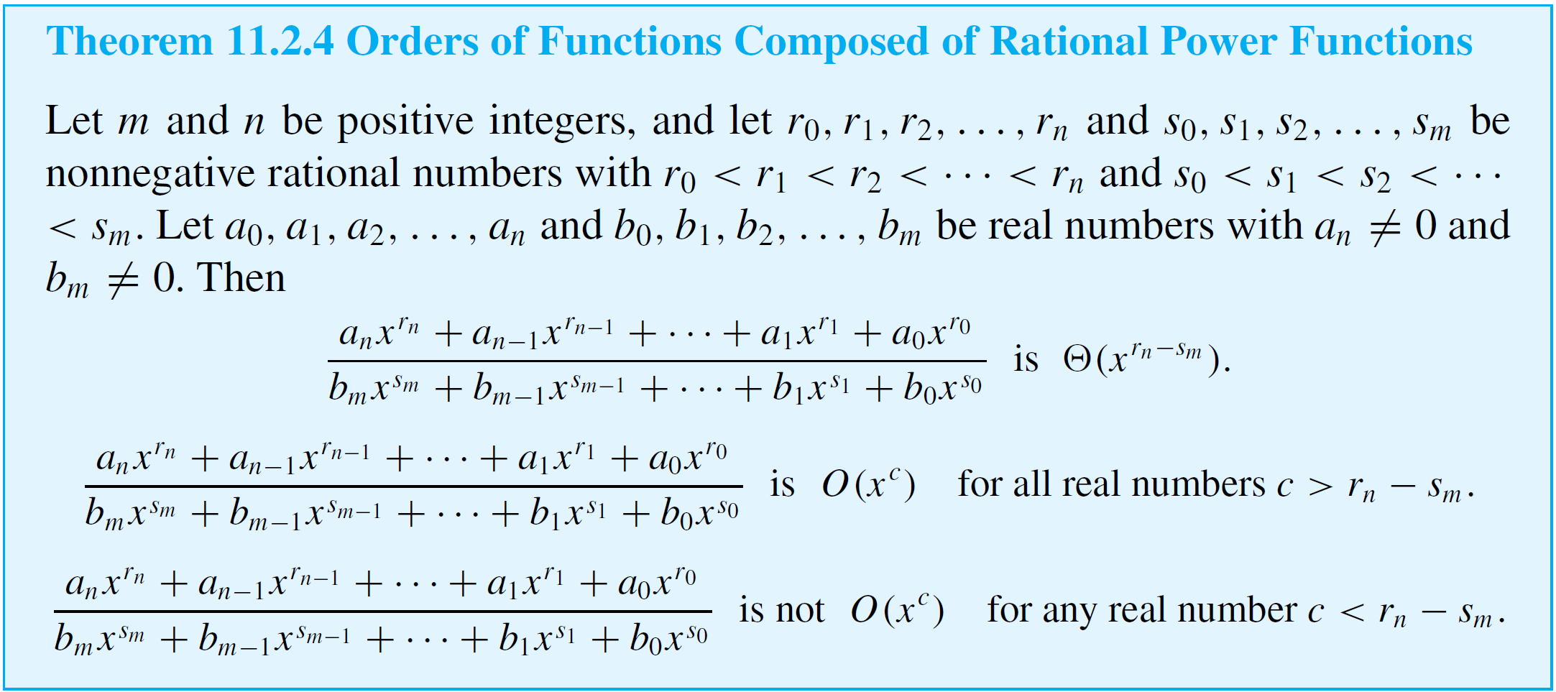
Extension to Functions Composed of Rational Power Functions

